Slide 1
How Your Current Policies
Relate to COVID-19

Slide 2

Policies that you have in place may already have you on the right path to protecting your workplace and staff.
Standards Covered:
General Duty Clause Act 154 R 408.1011, Sec 5(a)(1) https://www.osha.gov/pls/oshaweb/owadisp.show_document?p_id=3359&p_table=OSHACT
Bloodborne Pathogen Part 554 R 325.7, OSHA 1910.1030 https://www.michigan.gov/documents/CIS_WSH_part554_35632_7.pdf
PPE Part 6 R 408.406xx, 1926.28, 1928.102 https://www.michigan.gov/documents/lara/lara_miosha_CS_6_3-18-2013_414601_7.pdf
Respiratory Protection Part 451 325.600xx 1910.134 https://www.michigan.gov/documents/CIS_WSH_part451_54075_7.pdf

Slide 3

Protecting Yourself
  Understanding what you do that could potentially make you ill
  How to better protect yourself
  Universal precautions

Slide 4

Routes of Entry
Inhalation*
Mucous membranes
  When you touch your face you have a number of entry routes for the virus into your body
    Eyes
    Nose
    Mouth
*Information is changing daily

Slide 5

What Can You Do?
Social distancing
  Staying 6 feet away from one another whenever possible
Washing your hands
  Wash for at least 20 full seconds
Disinfecting surfaces
  The CDC offers a number of different ways surfaces can be properly (https://www.cdc.gov/coronavirus/2019-ncov/community/organizations/cleaning-disinfection.html)
Tools and equipment
  Personal vs Community use
  Where are they stored
  How often are they used
Notes:
Disinfecting: Use of EPA-registered household disinfectants should be effective

Slide 6


  Precautions taken whenever an employee is to be dealing with blood/bodily fluid or what they might think is blood/bodily fluid.
  Bloodborne Pathogen program/standard
  Top 3 universal precautions according to WHO (https://www.who.int/docs/default-source/documents/health-topics/standard-precautions-in-health-care.pdf?sfvrsn=7c453df0_2)
    Hand Hygiene
    Gloves
    Facial protection

Slide 7
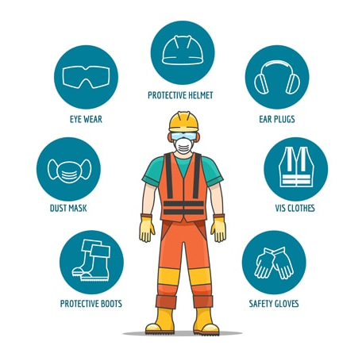
Personal Protective Equipment
Helps to prevent the spread of germs between workers
Does not guarantee total protection
Must be used in combination of precautionary measures such as hygiene (handwashing, sneezing into elbow, etc.)
Must be used properly to prevent a false sense of protection and potentially lead to self-contamination

Slide 8
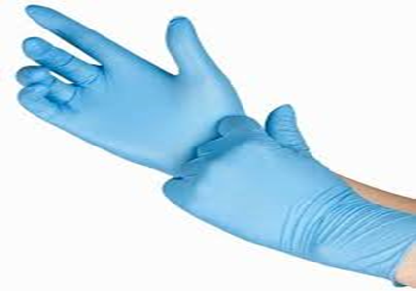
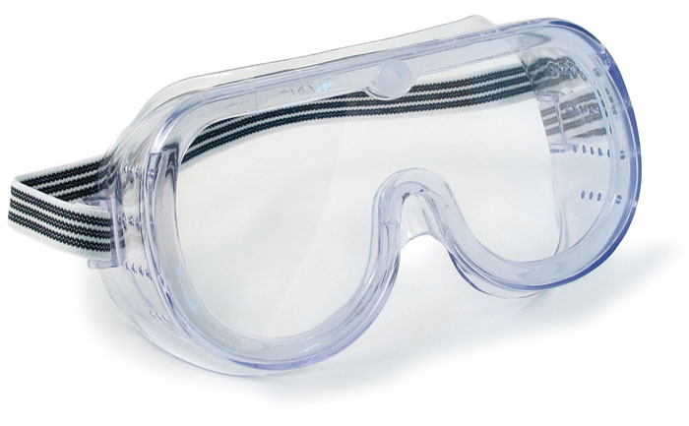
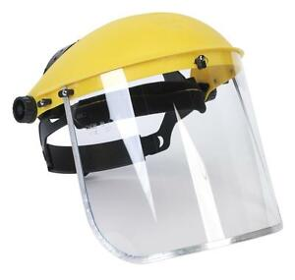
Types of PPE to Consider
Gloves - Must be non-permeable
Goggles - Preferred over glasses to prevent droplets from entering the eyes
Face Shields - Good at preventing large droplets from reaching the routes of entry

Slide 9
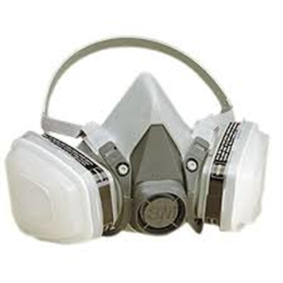
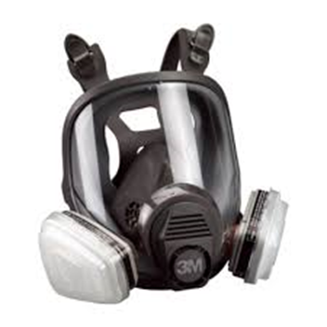
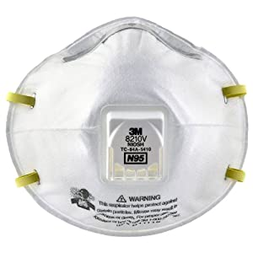
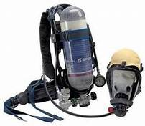
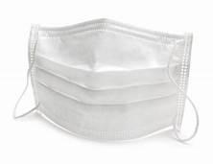
Respiratory Protection- 2 Types Available
Respirators – Half-mask, full face, N95, and SCBA.
Surgical masks

Slide 10

Respirators
Reduce the exposure to BOTH large and small airborne contaminants
Provide a tight seal so that inhaled air is pulled through air purifying cartridges
Must be NiOSH Certified
MUST be used in the context of a comprehensive respiratory protection program covered in OSHA 29 CFR1910.134
  Medical Evaluation
  Fit Testing
  Training Elements

Slide 11

Facemasks/Surgical Masks
Disposable
Loose Fitting - Not designed or certified to fit tightly or prevent inhalation of small airborne particulates
ONLY filters large droplets from being spread by person wearing it
Keeps splashes or sprays from reaching the nose or mouth
Only facemasks that are cleared by the FDA may be legally marketed in the US
Notes:
Help stop ONLY large droplets from being spread by person wearing it.
Keeps splashes or sprays from reaching the nose or mouth.
Not designed or certified to fit tightly or prevent inhalation of small airborne particulates because they can pass around the loose fitting edges of the mask.
Only facemasks that are cleared by the FDA may be legally marketed in the US

Slide 12




What Can YOU Do?

